Slide 1
Forms of Social Activism

Slide 2
Volunteer
assist disadvantaged and underprivileged people, and threatened species and/or habitats
internationally, volunteer to work in refugee camps, at local schools and medical care clinics, or for some other NGO (non-governmental organization)

Slide 3
Grassroots campaign
Publicize and gain support for your cause
E.g. Found or join community, student or other groups and then engage in ‘tabling’ (where you set up a table at some social event and hand out literature and talk about your cause)

Slide 4
Letters/Petitions
Send letters and petitions to the heads of the organizations which are the target of your activism, and also to your elected representatives

Slide 5
Consumer boycott
Refuse to purchase products from a company engaged in unethical activities

Slide 6
Ethical investing
Do not buy stocks/bonds of those companies involved in unethical practices, including those which:
conduct business with dictatorships and other repressive regimes
destroy the environment
practice discrimination
source goods from sweatshops

Slide 7
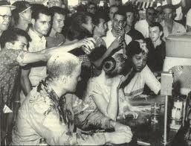
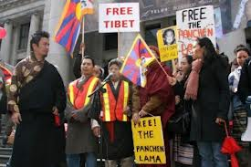
Demonstrate
protest against companies and other organizations (or groups) that are engaged in unethical activities.
E.g. marches, strikes, sit-ins and, in extremely serious circumstances (e.g., to protest murder), hunger strikes.

Slide 8
Civil disobedience/Direct Action
activists directly intervene in a situation and attempt to halt destruction on the spot (such tactics may lead to arrest). Examples include:
Blockades
Sitting in trees to prevent them from being cut down

Slide 9
Culture Jamming
Common tactics include re-figuring logos, fashion statements, and product images in order to expose concerns about our consumer culture, the media, etc.

