Slide 1
The Civil Rights Movement

Slide 2
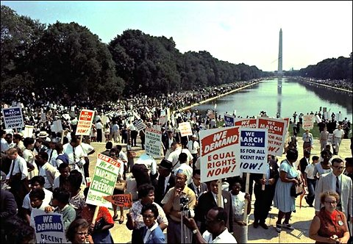
The goal . . .
to obtain for African Americans equal access to and opportunities for the basic privileges and rights of U.S. citizenship

Slide 3
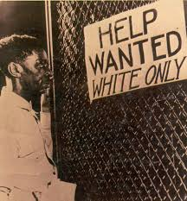
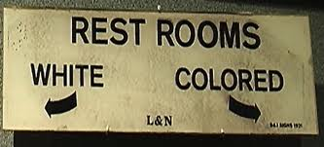
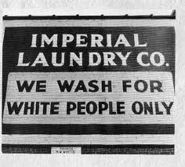
Jim Crow Laws
In the South, governments had passed segregation (racial separation) laws (aka ‘Jim Crow laws’) which permitted discrimination against Blacks.
These laws limited the number of Black people eligible to vote and mandated segregation in all areas of public life (e.g. schools, trains, theaters, hotels, restaurants, parks, restrooms, water fountains)

Slide 4
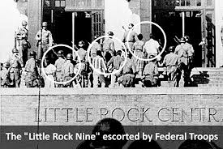
Brown v. Board of Education of Kansas, 1954
first real step toward ending segregation
Supreme Court ruled segregation in the public school system was unconstitutional
Many whites very upset with that decision; KKK and other groups resisted desegregation, often resorting to violence.
Federal troops had to be sent in to protect Black students integrating white schools

Slide 5
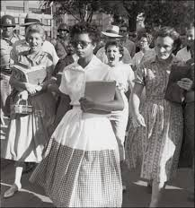
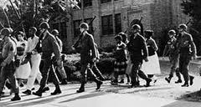
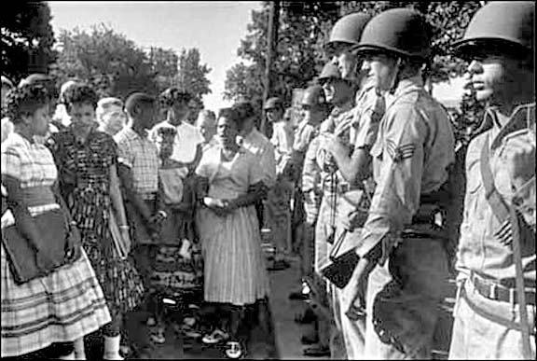
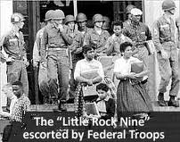

Slide 6
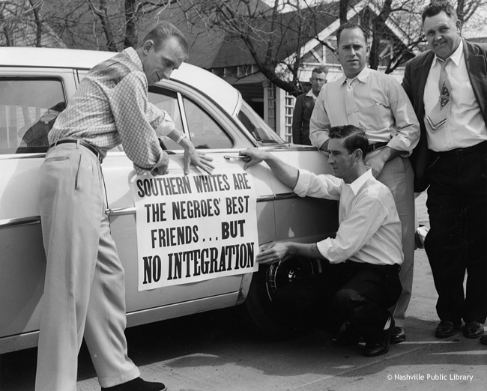
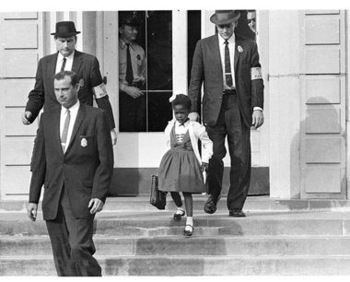
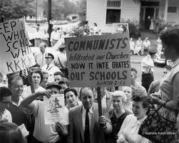
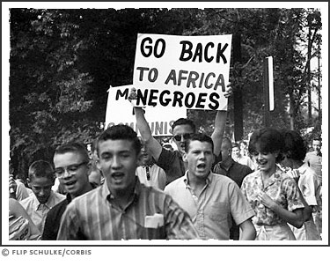

Slide 7
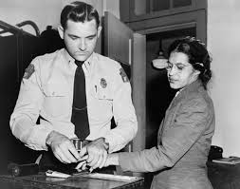
Montgomery Bus Boycott, 1955
Rosa Parks arrested when she refused to follow Alabama law requiring blacks to give up their seats to white passengers on city buses
Martin Luther King, Jr., who advocated non-violence, organized bus boycott (lasted for almost one year)
Supreme Court struck down bus segregation law in the city

Slide 8
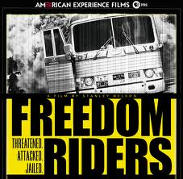
Freedom Riders/Sit-ins
interracial group of ‘Freedom Riders’ rode buses through South in 1961 to challenge segregation
badly beaten by angry mobs in several cities
black students sat down at segregated lunch counter in N. Carolina and refused to leave; more sit-ins occurred thereafter, during which protesters were beaten, abused and arrested
Bad publicity/boycotts forced department stores stores to serve blacks

Slide 9
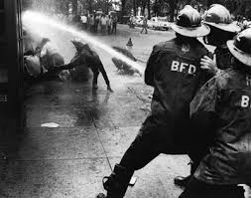
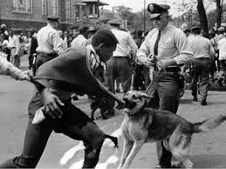
Birmingham, Alabama marches
In 1963, Martin Luther King and others led marches, demanding integration (bringing races together); marchers were jailed
Black parents pulled kids out of school and had them march, an event known as ‘The Children’s Crusade’; police chief loosed police dogs and fire hoses on the young marchers

Slide 10
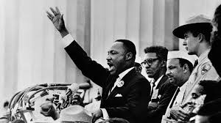
Washington D.C. March, 1963
More than 250,000 from all over U.S. marched
Wanted to pressure Congress to pass the Civil Rights Bill (ensuring equal rights for blacks)
M.L.K. Jr. delivered famous “I have a dream” speech
In 1964, President Johnson signed Civil Rights Bill

Slide 11
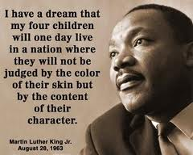
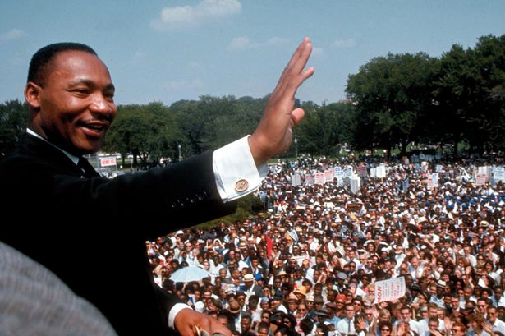
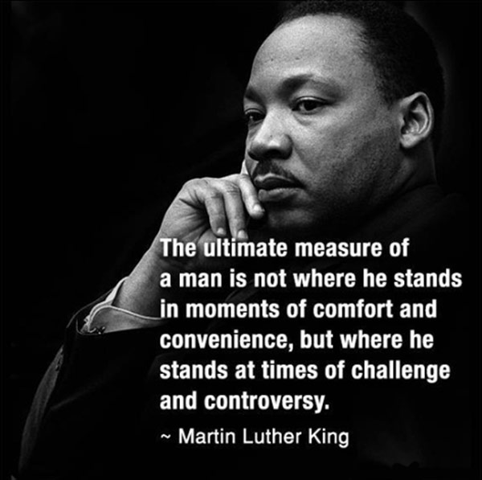
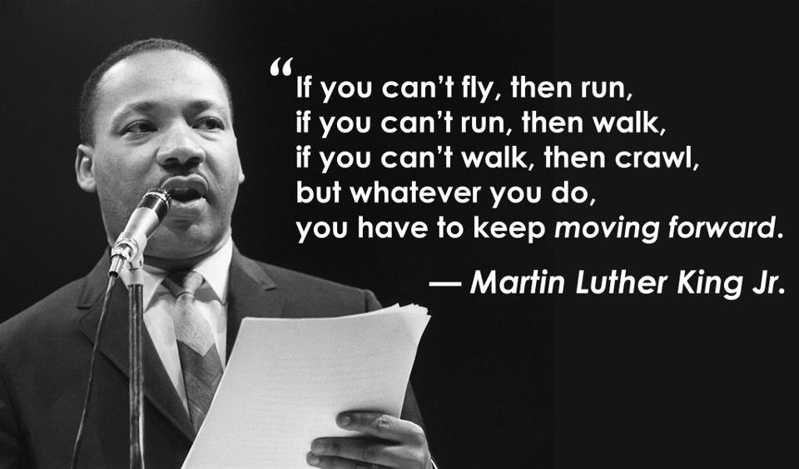

Slide 12
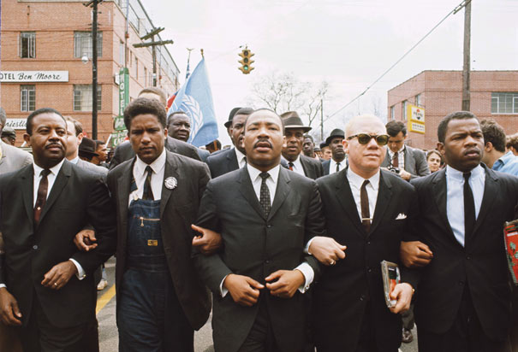
Alabama Freedom March, 1965
In Alabama and other states, black people still kept from voting (those who tried to register given hard time; almost any excuse used to keep them from voting)
The 3000 marchers, led by M.L.K., Jr. gained attention needed to pass a new ‘voting rights bill’

Slide 13
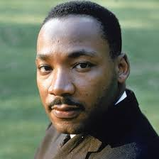
Assassination
M.L.K., Jr. assassinated in 1968 in Memphis
In his last speech, the day prior to his death, he said: “But death doesn’t matter to me now, because I’ve been to the mountaintop. And I’ve looked over, and I’ve seen the promised land. I may not get there with you. But I want you to know that we as a people will get to the promised land. So I’m happy I’m not fearing any man. Mine eyes have seen the glory of the coming of the Lord.”

Slide 14
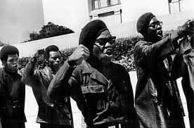
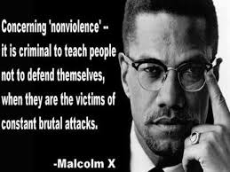
Black Power
By mid 1960s, some younger activists, discontented with slow change, became more militant
Advocates of black power favored racial separatism and self-defense against white violence
Leading group = Black panthers
Best known figure in radical wing of civil rights movement = Malcom X of the Nation of Islam
By early 1970s, black power was all but non-existent, failing to have gained support of most African Americans

