Slide 1
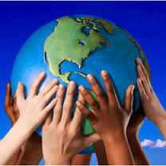
Equity, Diversity and Social Justice

Slide 2
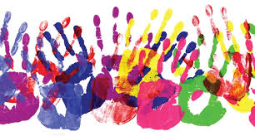
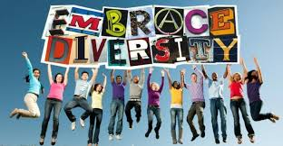
What is Diversity?
The ways in which people differ from one another (e.g. race, age, gender, socioeconomic class, culture, language, sexual orientation, religion)

Slide 3
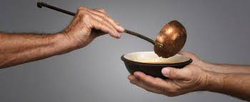
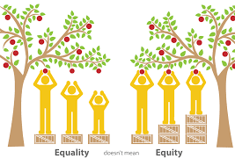
What is Equity?
Equity is about treating people fairly, but not necessarily equally (in the exact same way)
It involves making sure people have access to the same opportunities
Examples: building a ramp so that those in wheelchairs have access to a building; providing financial assistance to students from low income families

Slide 4
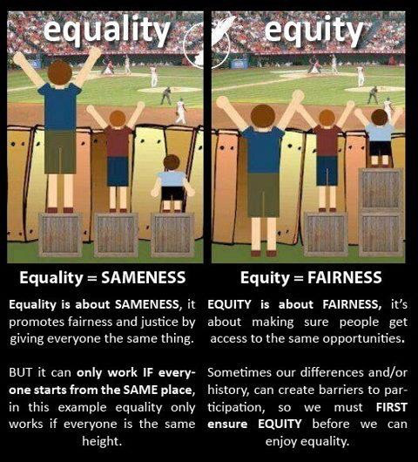

Slide 5
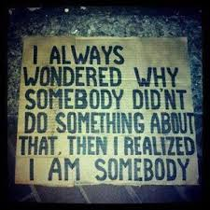
What is Social Justice?
This is the promotion of human rights and equity (fairness) in our society
Addresses issues like discrimination and poverty

