Slide 1
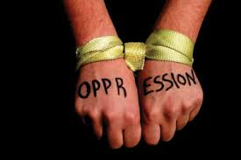
Power and Oppression in Society

Slide 2
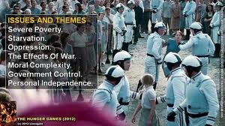
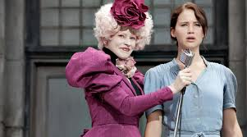
Minoritized group(s):
A social group that is devalued in society; this devaluing encompasses how the group is represented, what degree of access to resources is granted, and how the unequal access is rationalized

Slide 3
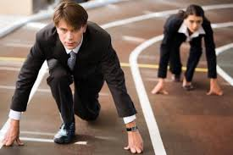
Dominant group(s):
The group(s) at the top of the social hierarchy; the group that is valued more highly in society and thus has more power (in terms of setting norms, making decisions, etc.)

Slide 4
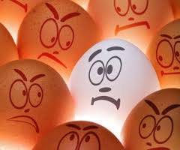
Oppression:
The hold down (‘press’) and deny a social group full access and potential in a given society (e.g. Not permitting a group to vote)
Occurs when one group’s prejudice is backed by historical, social and institutional power (laws, customs, practices, organizations, etc.):
Prejudice/Discrimination + Power = Oppression

Slide 5
Forms of Oppression
Type of Oppression:
Dominant/Minoritized groups:
Racism . . . . . . . . . . . . . . . . . .
Classism . . . . . . . . . . . . . . .
Sexism . . . . . . . . . . . . . . . . .
Heterosexism . . . . . . . . . . . .
Ableism . . . . . . . . . . . . . . . . .
Whites / people of colour
Wealthy / poor
Men / Women
Heterosexuals / Homosexuals and Bisexuals
Able-bodied / People with disabilities

