Slide 1
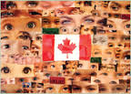
Ethnocultural Diversity in Canada

Slide 2
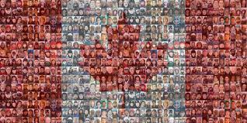
Canadian Multiculturalism Act, 1988
ensures that every Canadian receives equal treatment by the government, which respects and celebrates diversity
acknowledges the freedom of all members of Canadian society to preserve, enhance and share their cultural heritage

Slide 3
‘Diversity Stats’
1 in 5 Canadians foreign-born
Asia (including the Middle East) is our largest source of immigrants
In the 2011 status, the most common ethnic origins reported were: Canadian (10.5 million), English (6.5 million), French (5 million), Scottish (4.7 million), Irish (4.5 million), German (3.2 million)
Other ethnic groups that surpassed 1 million were: Italian, Chinese, First Nations, Ukrainian, East Indian, Dutch and Polish

Slide 4
1 in 5 Canadians is a visible ethnic minority
Largest visible minority groups = South Asians (East Indian, Pakistani or Sri Lankan), Chinese and Blacks

Slide 5
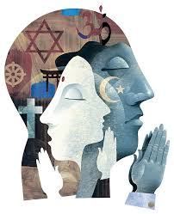
Religious Diversity in Canada
67% = Christian
24% = no religious affiliation
7% = Muslim, Hindu, Sikh or Buddhist
1% = Jewish

Slide 6
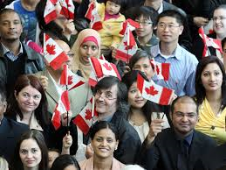
Possible challenges facing newcomers to Canada . . .
The need to learn a new language
Different social role expectations
Lack of recognition for international qualifications
Prejudice/discrimination
Separation from family
Conflict between values in the family and the new society
Different expectations regarding citizens rights

Slide 7
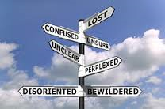
Culture shock = the confusion and anxiety a person may have after leaving a familiar culture to live in a new and different culture

Slide 8
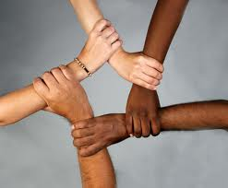
Benefits of Diversity
Immigrants help to sustain our health care, pension plans and social programs
Immigrants can give companies an edge in a competitive global economy
Increased innovation, creativity, different skills introduced to our society
Increased awareness and understanding of other cultural groups
Music, food, etc.

Slide 9
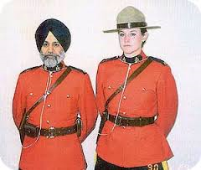
Discussion question:
Is it possible to maintain a strong national identity in a multicultural nation like Canada? How?

Slide 11
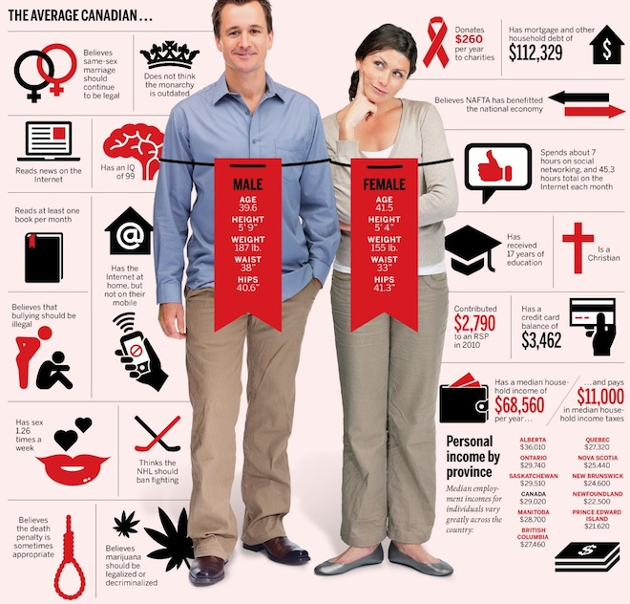

Slide 12
