Slide 1
Human Rights in Canada

Slide 2
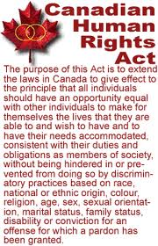
Canadian Human Rights Act, 1977
ensures equal opportunity to individuals who may be victims of discriminatory practices based on a set of prohibited grounds such as sex, disability, or religion
applies throughout Canada to federally regulated activities

Slide 3
Canadian Charter of Rights and Freedoms, 1982
The Charter sets out those rights and freedoms necessary in a free and democratic society. Some are:
•freedom of expression
•the right to a democratic government
•the right to live and to seek employment anywhere in Canada
•legal rights of persons accused of crimes
•Aboriginal peoples' rights
•the right to equality, including the equality of men and women
•the right to use either of Canada's official languages
•the right of French and English linguistic minorities to an education in their language
•the protection of Canada's multicultural heritage.

Slide 4
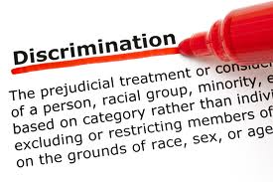
Ontario Human Rights Code, 1962
Protects against discrimination in housing, customer service, employment, etc.

Slide 5
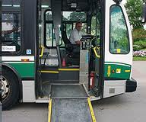
Ontarians with Disabilities Act, 2001
Purpose = to improve the identification, removal and prevention of barriers faced by persons with disabilities (mental health, physical, learning or developmental disabilities)

Slide 6
Accessibility for Ontarians with Disabilities Act, 2005
Involves people with disabilities in developing accessibility standards (to be enforced by the government)
Goal = to achieve accessibility for those with disabilities with respect to transportation, customer service, design of public places, employment, and information/communications by 2025

