Slide 1
Hate Crimes and Canada’s Criminal Code

Slide 2
What is a Hate Crime?
According to Canada’s Criminal Code, a hate crime is “committed to intimidate, harm or terrify not only a person, but an entire group of people to which the victim belongs. The victims are targeted for who they are, not because of anything they have done.”

Slide 3
hate is the motive and the crime can involve intimidation, harassment, physical force or threat of physical force against a person, a group or a property

Slide 4
The Criminal Code of Canada
Section 318: it is a criminal act to "advocate or promote genocide" — to call for, support, encourage or argue for the killing of members of a group based on colour, race, religion, ethnic origin or sexual orientation

Slide 5
Section 319: it is illegal to publicly stir up or incite hatred against an identifiable group. It protects people from being if their statements are truthful or the expression of a religious opinion.
A swastika was spray-painted on a sign at the House of Jacob synagogue in Calgary in November 2009

Slide 6
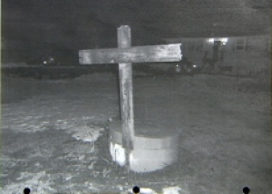
Section 430 covers hate-motivated mischief (e.g. vandalism) and religious property
The section of the code on sentencing encourages judges to consider whether the crime was motivated by hate
Two Nova Scotia men were convicted under Canada's hate crime laws in relation to a cross-burning incident on the lawn of an interracial couple in Windsor, N.S. The photo is from the RCMP.

Slide 7
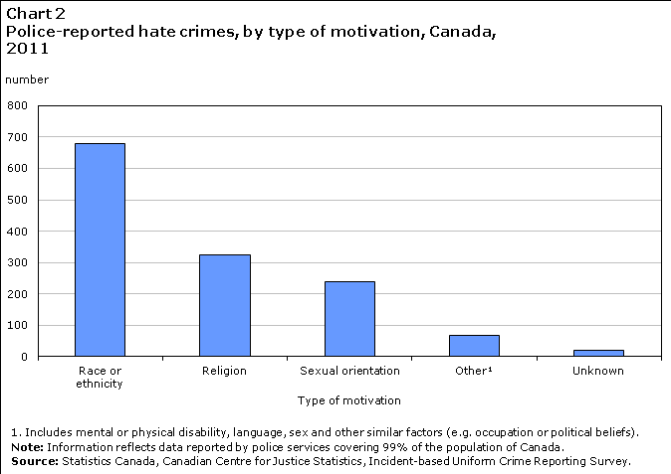
http://www.statcan.gc.ca/pub/85-002-x/2013001/article/11822/c-g/c-g02-eng.gif

Slide 8
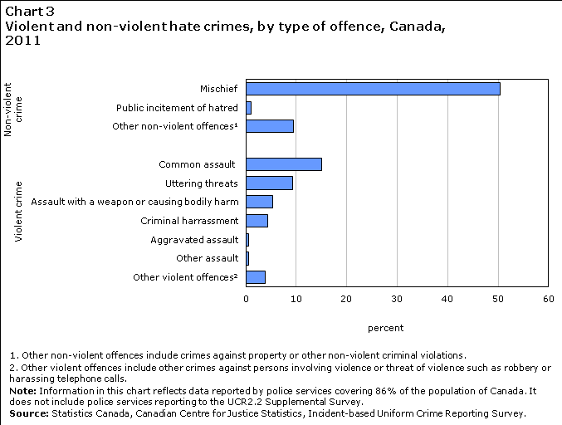

Slide 9
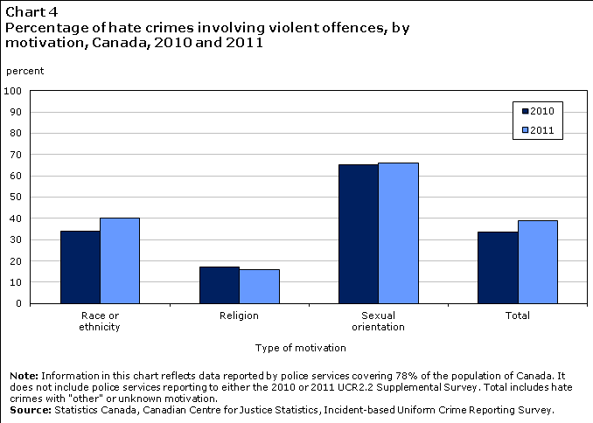

Slide 10
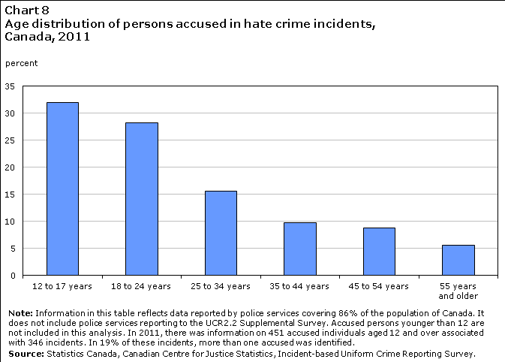

Slide 11
