Slide 1
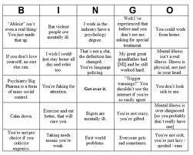
Ableism

Slide 2
Ableism =
Ableism is a form of discrimination or prejudice against individuals with physical, mental, or developmental disabilities that is characterized by the belief that these individuals need to be fixed or cannot function as full members of society

Slide 3
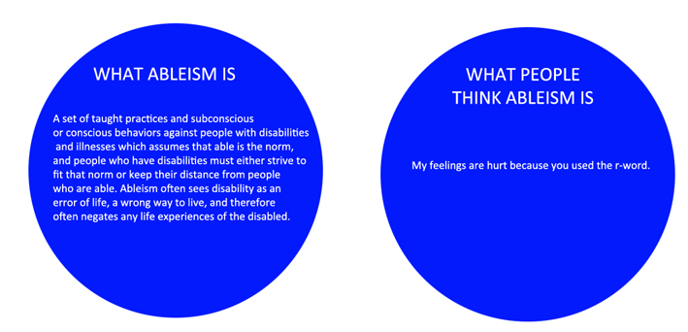

Slide 4
Percent of Disabled Population

Slide 5
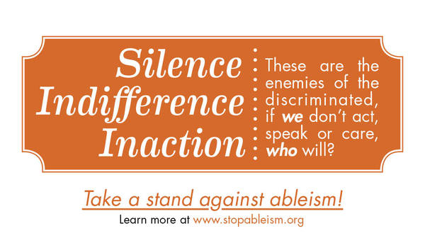

Slide 6
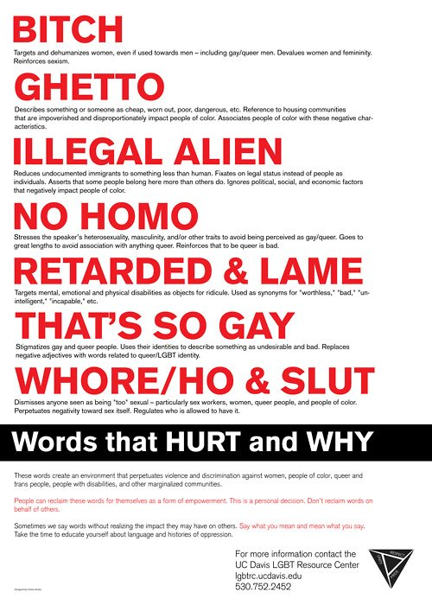

Slide 7
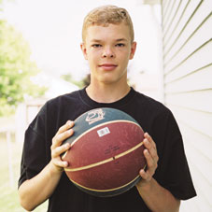
Jason McElwain’s Story

Slide 8
Quotes
“What we all want in life is a shot. But what we do with it, that's the story we all want to tell.”
“Diagnosed with autism at 2 years old, [J Mac] has never considered himself special or different, especially when it comes to sports.”
J Mac: “It's not really a big deal at all. I'm just normal like other people. That's the way I am.”

Slide 9
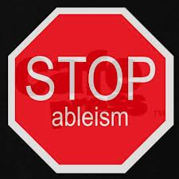
The Impact of Ableism
Feeling that you are “living in a world not built for me”
Dealing with assumptions about intellectual capacity and physical limitations
Ignorance and lack of care by others
Bathroom
Parking Spots
Inaccessible areas
Comments
“Watch out for that wheelchair!!”
Depersonalization

Slide 11
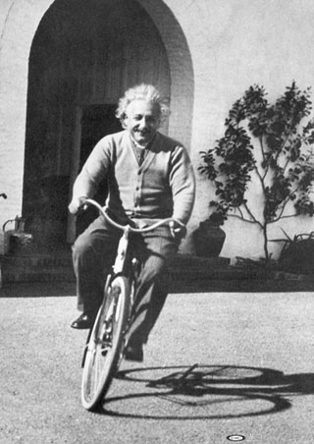
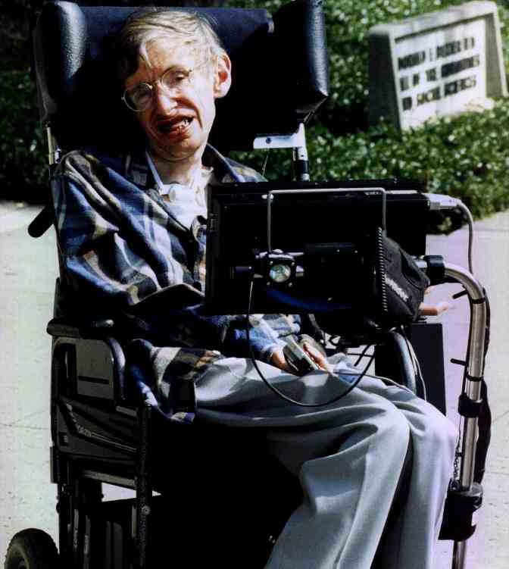
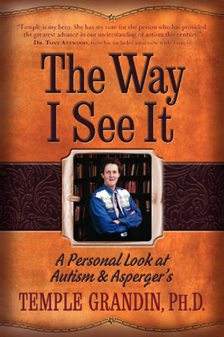
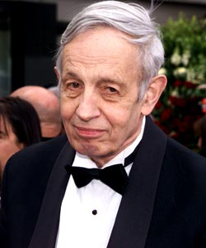
Do not worry about your problems with mathematics, I assure you mine are far greater." - Albert Einstein

