Slide 1
Aboriginal Rights: Issues and Controversies

Slide 2
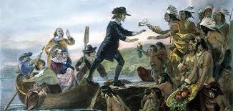
History
During the settlement and colonization of Canada by Europeans, many treaties were negotiated between the Crown and local Aboriginal populations
Most treaties deal with land claims, logging, fishing, hunting and taxation

Slide 3
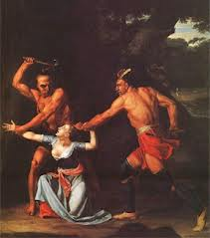
The Europeans’ belief in their superiority over other cultures had a major role in the destruction, oppression and suppression of Aboriginal civilizations
Aboriginals were viewed as barbaric, subhuman and savage

Slide 4
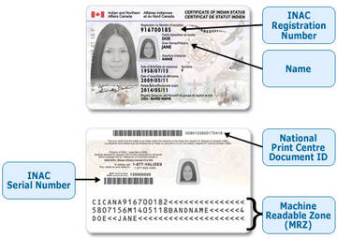
Indian Act (1876)
Set up the Reserve system
Decided who had Indian status
Claiming Indian status made someone a ‘ward’ of the Canadian government
Denied aboriginals full Cdn. Citizen status (e.g. voting rights)

Slide 5
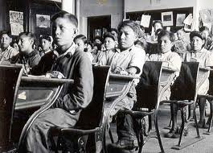
Residential School System
Started in the late 1800s, when Aboriginal children were removed from reserves and sent to schools far away
The goal = assimilation (eradicate all that was ‘Indian’ in the children)
School life was modeled after military life
children weren’t allowed to speak their native language
schools were operated by
Christian churches

Slide 6
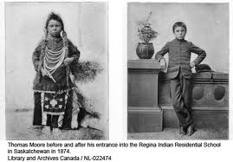
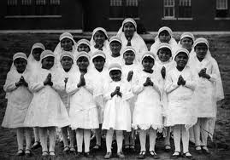
Years later, reports of physical, emotional and sexual abuse surfaced
Schools were shut down in the 1970s and 1980s
Legal compensation settlements are ongoing
PM Stephen Harper issued a formal apology in 2008

Slide 7
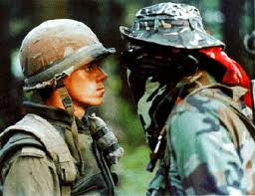
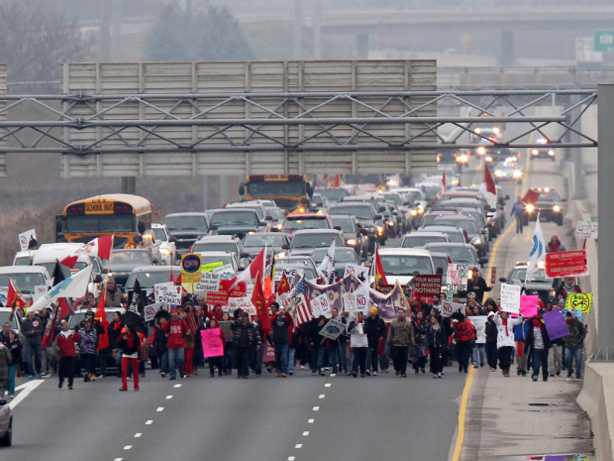
Conflicts/Protests
The Oka Crisis, 1990
Ipperwash, Ontario, 1995
Burnt Church, 1999
‘Idle No More’, began 2012
“OUR PEOPLE AND OUR MOTHER EARTH CAN NO LONGER AFFORD TO BE ECONOMIC HOSTAGES IN THE RACE TO INDUSTRIALIZE OUR HOMELANDS. IT’S TIME FOR OUR PEOPLE TO RISE UP AND TAKE BACK OUR ROLE AS CARETAKERS AND STEWARDS OF THE LAND.”
— Eriel Deranger
Athabasca Chipewyan First Nations

