Slide 1
Caste System

Slide 2
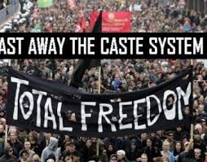
A caste system is a closed system of social stratification where a person’s permanent social status is determined at birth
One’s position at birth generally determines the type of work one will perform

Slide 3
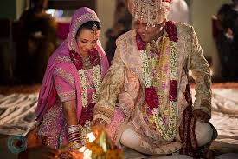
Those in a caste system are allowed to marry only within their own group
One typically socializes only with those in their own group
Cultural and religious beliefs generally sustain these systems

Slide 4
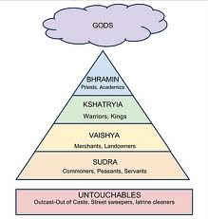
Caste System in India
In the past, segregation between those of different castes was enforced socially and legally (e.g. it was illegal to marry outside one’s caste)
Although now illegal, discrimination based on caste still impacts Indian culture

Slide 5
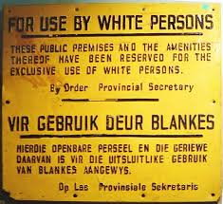
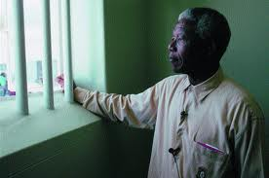
Caste System in South Africa
The caste system was based on race
Apartheid was an official policy involving political, legal and economic discrimination against non-whites
Although now illegal, some prejudice and discrimination remains (e.g. white people usually hold most desirable jobs)

