Slide 1
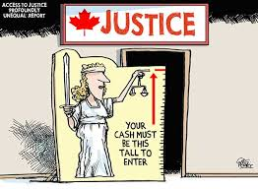
Social Stratification: Class Systems

Slide 2
Social Class =
a segment of society whose members hold similar amounts of resources and often share values, norms, lifestyle, education and type of work
In Canada, we identify the classes (based on jobs/wealth) as upper, middle, working and lower

Slide 3
Class systems . . .
are more open than slavery or caste systems
offer the opportunity to those who gain the necessary education and skills to move from one level of society to another
still may discriminate against certain groups, who might have more difficulty getting the best jobs or earning the highest pay (e.g. young people, women, minority races, older people, those with disabilities)

Slide 4
