Slide 1
Masculinity in the Media

Slide 2
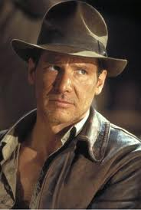
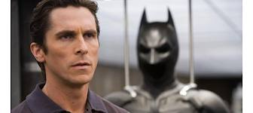
In the media, male characters often. . .
keep their attention focused largely just on women and girls
are tough, violent and/or angry
are leaders and problem solvers
are funny, confident, successful and athletic

Slide 3
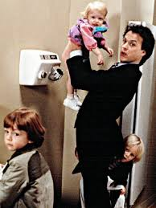
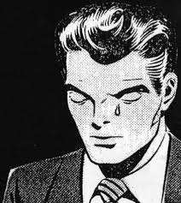
Male characters rarely . . .
Cry or show other signs of vulnerability
Are shown doing domestic (household) chores

Slide 4
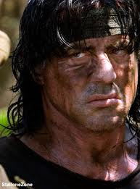
Consequences?
Portrayal of men as socially powerful and physically violent reinforces assumptions about how men and boys should act, how they should treat each one another, as well as how they should treat women and children

Slide 5
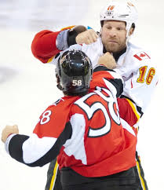
Sports coverage/commentary . . .
often praises athletes who continue to play while injured
Uses language of conflict and war to describe action
Focuses heavily on violence, often replaying and over-analyzing footage of graphic injuries, accidents and fights

Slide 6
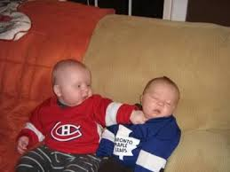
Consequences?
Focus on personal rivalry, conflict and fierce competition reinforces the attitude that violence and aggression are normal and natural expressions of masculine identity

