Slide 1
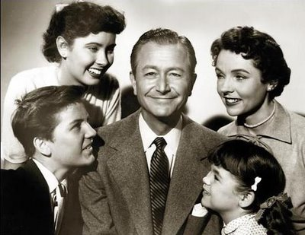
Media Stereotypes

Slide 2
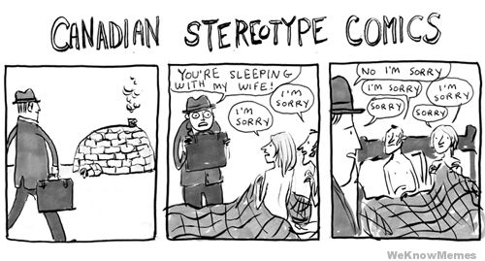
What is a stereotype?
An over-simplified, generalized belief about all people who belong to a certain social group (e.g. Canadians are nice)
When we stereotype a group of people, we depict all of the individuals within that group as having the same characteristics

Slide 3
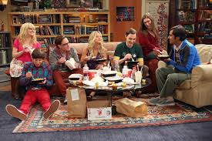
Why are stereotypes common on T.V.?
Since most T.V. shows are quite short, the identities of characters must be established as quickly as possible
To do this, writers often use stereotypes so that the audience can easily ‘recognize’ and ‘understand’ the characters

Slide 4
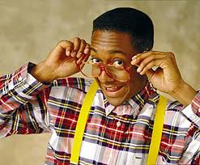
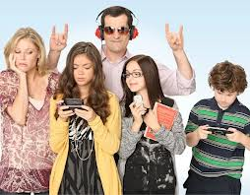
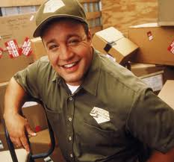
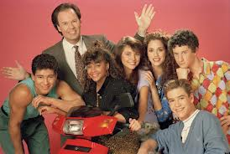
People on T.V. are stereotyped because of their . . .
Age
Sex
Job
Culture
Race
Looks
Position in a family

Slide 5
Negative consequences?
Stereotypes can affect the way viewers perceive different groups (e.g. females, males, the elderly, minority races), giving us false impressions
Stereotypes often present a one-sided, negative image of many groups
they can limit our expectations of others and possibly of ourselves

Slide 6
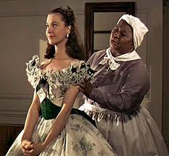
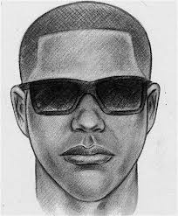
Racial stereotypes (examples):
Traditionally, Blacks were portrayed as either happy-go-lucky servants or dangerous criminals

Slide 7
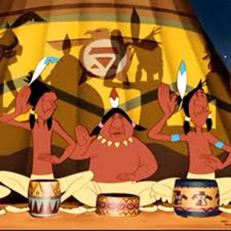
Aboriginals were portrayed as animal-skin wearing teepee dwellers
Often shown as devious and violent or submissive and passive

Slide 8
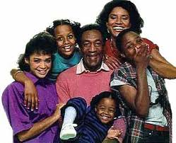
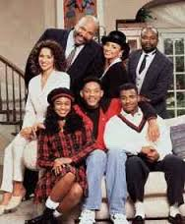
Challenging the Stereotypes?

Slide 9
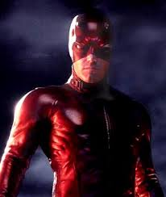
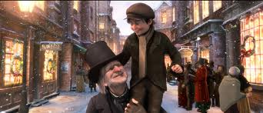
Common Stereotypes of People with Disabilities:
‘Victim’: presented as helpless object of pity (e.g. Tiny Tim in A Christmas Carol)
‘Hero’: character proves his/her worth by overcoming the disability (e.g. Daredevil)
‘Villain’: the disability is used to suggest evil or depravity (e.g. pirates with missing hands, eyes)

Slide 10
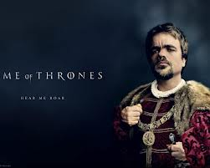
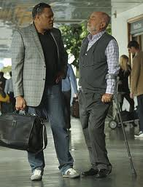
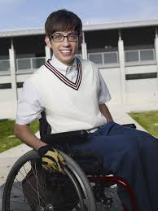
Challenging the Stereotypes?

Slide 11
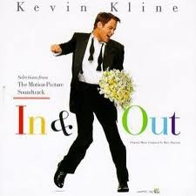
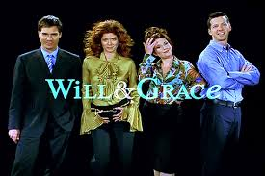
Common Stereotypes of Gay Men
Gay men often portrayed as over-the-top feminine, flamboyant and fashionable and/or uptight and insecure about their sexuality

Slide 12
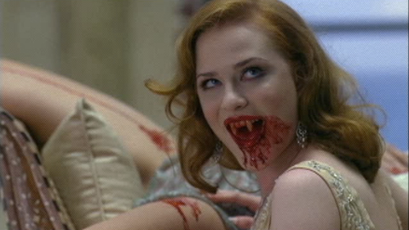
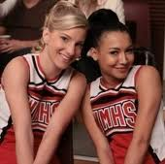
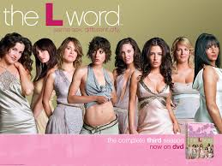
Common Stereotypes of Lesbians
Often portrayed as gorgeous, curvy women; often the characters are bisexual

Slide 13
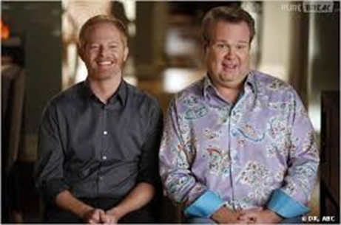
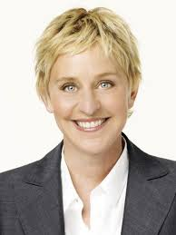
Challenging the Stereotypes?

