Slide 1
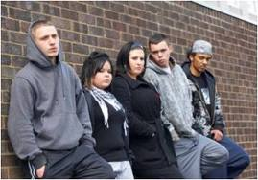
Teens Living in Poverty

Slide 2
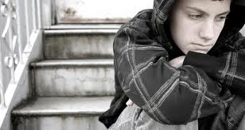
Emotional Difficulties
Lives are often filled with emotional and social instability
Parents may have to move frequently to find housing, which disrupts social relationships and schooling
More likely to experience depression, low self-esteem and a sense of powerlessess

Slide 3
Academic issues
Poverty creates chronic stress which makes impairs attention and concentration
When teens are struggling to get basic needs met, schoolwork is often not a priority

Slide 4
Crime
When teens living in poverty don't see a way to obtain legitimate employment, crime becomes an appealing alternative
In urban areas, teens living in poverty are tempted by gang members who promise them income as well as a source of emotional support that they don't feel at home

